Slide 1
Polluting sys_execve()
www.shellcode.com.ar

Slide 2
Goodfellas
Security Research Team
  -Discovered by
    Jonathan Sarba
    Ignacio marambio

Slide 3
Introduction
Registration Weakness in Linux Kernel's Binary formats

Slide 4
Introduction
Design weakness, handling of simply linked lists.
Affects all the kernel families (2.0/2.2/2.4/2.6)
  SMP family is not affected.

Slide 5
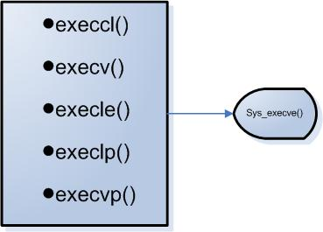
Introduction
Sys_execve() family

Slide 6
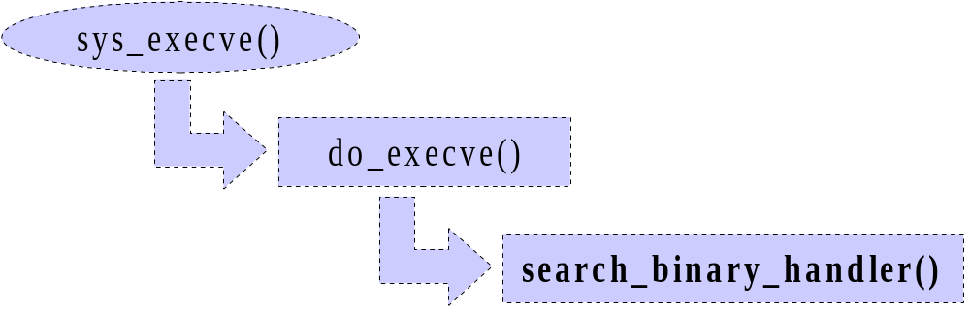
Sys_execve()

Slide 7
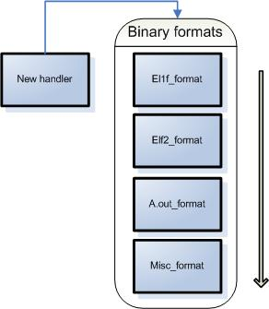
Binary Format list
Register_binfmt()

Slide 8
Binary format list
The function only verifies, if the new format exists or not in the list.

Slide 9
Impact
The ‘infection’ format will be invoked before any other.
Affects all the system process.
Injection of Infection Modules in kernel-space

Slide 10
Detection
Strace / Ltrace debugging tools are out of context [no possible debug] acts in Kernel-space.

Slide 11
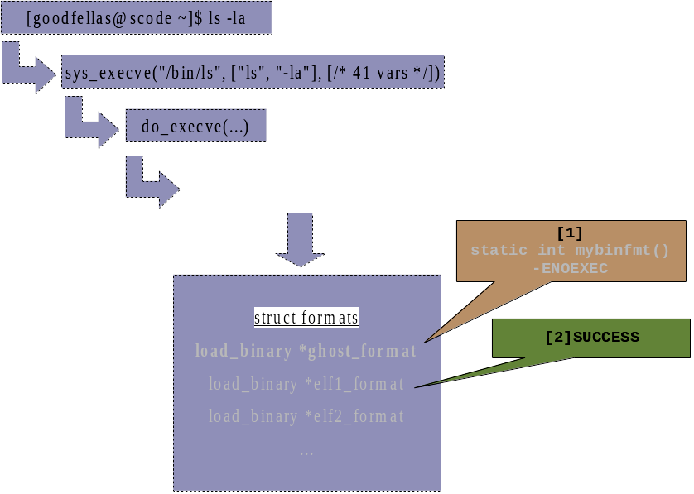
Proof of Concept

Slide 12
Proof of Concept
Ghost.c
[POC] rootkit privilige elevation of any process running in the ‘infected’ system.

Slide 13
Limitations
The module can’t be blocking
  Example, PortBinding
You must be root :D

Slide 14
NOTABUG
Alan Cox [kernel developer]
  It’s used to debug elf_loaders, “It’s a Feature”

Slide 15
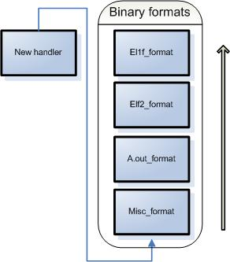
Work Around
Kernel Patch
  Not definitive patch

Slide 16
Questions
?

Slide 17
Thanks
Personal Mail: fedek@shellcode.com.ar
Research Crew: goodfellas@shellcode.com.ar
http://www.shellcode.com.ar

